Slide 1

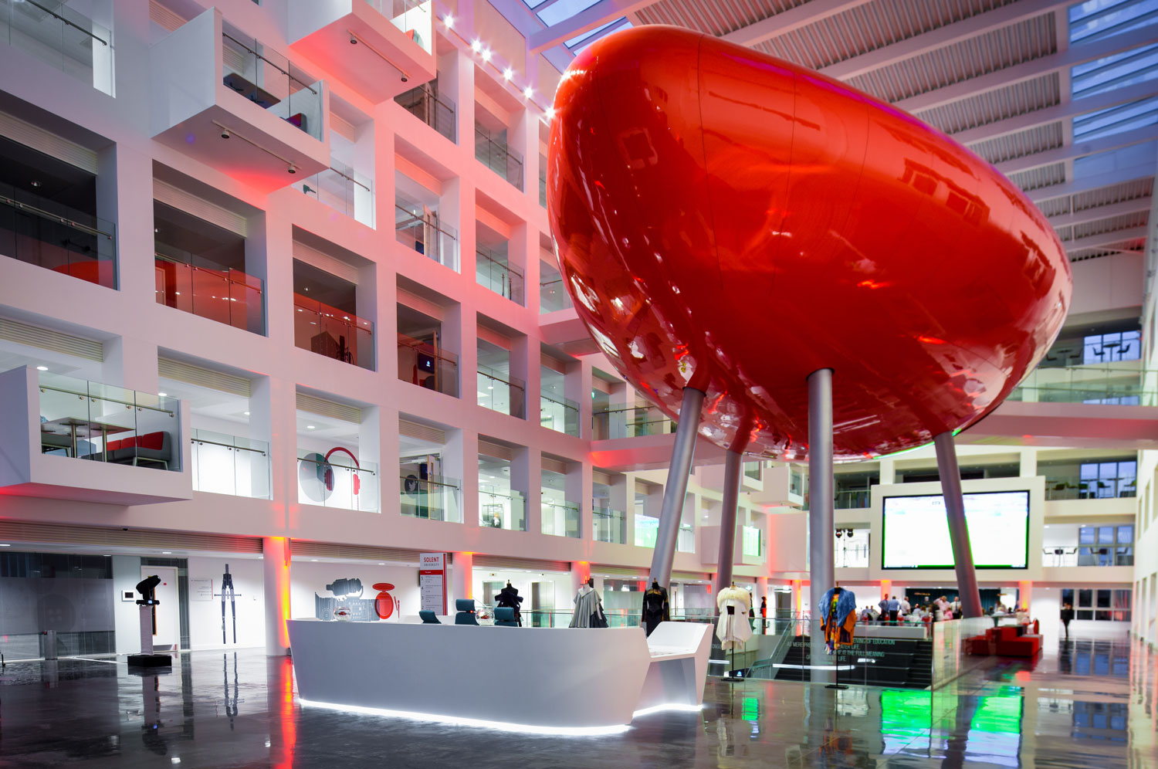


Cybercrime and Digital Forensics (COM622)
Department of Science & Engineering
Solent University
Week 8 Lecture: Live Forensic and Virtuality
Dr Daniel Olabanji

Slide 2

Session Overview
Recap on Investigation analysis and Types
Live analysis
Virtualisation and Digital Forensic

Slide 3
Investigation
There are Three (3) major forms of investigation analysis in Digital Forensics, and they are :
Static Analysis
Mounted Analysis
Live Analysis
Each has its differences, advantages and disadvantages

Slide 4
Static Analysis
Static analysis in digital forensics involves examining data without executing it. This method is often used to analyse malware, files, and systems in a controlled environment.
Data at Rest: This involves examining data stored on devices such as hard drives, USB drives, CDs, and other storage media.
System Shutdown: Typically, the system is powered down to prevent any changes to the data. This helps preserve the integrity of the evidence.
Forensic Imaging: Investigators create a forensic image, which is an exact bit-by-bit copy of the storage media. This allows them to analyse the data without altering the original evidence.
Analysis Tools: Various forensic tools are used to examine the data. These tools can recover deleted files, analyse file systems, and search for specific types of data.
Documentation: Detailed records of the findings are maintained to ensure that the evidence can be presented in court if necessary.

Slide 5
Static Analysis
Provide a safe way to investigate and understand digital evidence
Very dependent on your knowledge of the target OS
Very dependent on your skills with the investigation tool
Examples of Tool for Static Analysis
Autopsy
Ftk
Encase
Xways
MSAB XRY
and many more
Our assessment will be based on this analysis. Although there will be hands on try on the other form of digital forensic investigation analysis.

Slide 6
Mounted Analysis
Mounted analysis in digital forensics involves mounting a forensic image of a storage device so that it can be examined as if it were the original device.
Here are the key steps and aspects:
Forensic Imaging: First, a forensic image of the storage device is created. This is a bit-by-bit copy of the entire device, ensuring that all data, including deleted files and slack space, is captured.
Write-Blocking: To maintain the integrity of the evidence, a write-blocker is used. This device allows the data to be read without any risk of altering it.
Mounting the Image: The forensic image is then mounted using forensic software. This process makes the image accessible as if it were a physical drive, allowing investigators to navigate the file system and examine the data.

Slide 7
Mounted Analysis cont.
Read-Only Mode: The image is typically mounted in read-only mode to prevent any changes to the data. This ensures that the evidence remains unaltered and admissible in court.
Analysis Tools: Various tools can be used to analyse the mounted image. These tools can search for specific files, recover deleted data, and identify hidden or encrypted files.
Documentation: All findings are meticulously documented to ensure that the evidence can be presented in a legal setting if necessary.
Advantage and Disadvantage
Easier to view and export documents
Easier to find locations and files of 'interest'
Allows virus scanning (but not registry scanning)
Not forensically 'safe' so you must work on a copy
You must be able to identify the changes made in court...

Slide 8
Notable Case where Mounted Analysis was used
The BTK Killer, Dennis Rader case.
Case Overview: Dennis Rader, known as the BTK Killer (Bind, Torture, Kill), terrorized Wichita, Kansas, for over three decades, committing ten murders between 1974 and 1991. He taunted law enforcement with letters and clues, but his identity remained a mystery until 2005.
Digital Breakthrough: In 2004, Rader sent a floppy disk to the police, believing it was untraceable. However, digital forensic experts were able to recover deleted data from the disk. They mounted the forensic image of the floppy disk and analysed the metadata, which led them to a computer at a local church. This critical piece of evidence allowed investigators to zero in on Rader.
Outcome: The mounted analysis of the floppy disk’s forensic image provided the breakthrough needed to identify and arrest Dennis Rader. He was subsequently convicted and sentenced to life imprisonment.

Slide 9
Live Analysis
Live analysis in digital forensics involves examining a system while it is still running. This approach is crucial for capturing volatile data that would be lost if the system were powered down.
key aspects:
Volatile Data Collection: Live analysis focuses on capturing data stored in volatile memory (RAM), such as running processes, open network connections, and active sessions¹.
System Tools: Various tools are used to gather and analyse data without shutting down the system. These tools can capture memory dumps, identify running processes, and extract data from active network connections.
Incident Response: Live analysis is often part of an incident response process, allowing investigators to understand ongoing attacks and take immediate action to mitigate threats.

Slide 10
Live Analysis
Chain of Custody: Maintaining the chain of custody is crucial. The system is typically kept in a controlled environment to ensure that the evidence remains admissible in court.
Documentation: Detailed records of the live analysis process and findings are maintained to ensure that the evidence can be presented in legal proceedings if necessary.
Advantage and Disadvantage
Involves booting virtual system from the operating system on the investigation disk
It allows the investigator to see the disk from the suspect's point of view
It allows you to investigate hidden system behaviour, e.g. network activity
A comparison with mounted analysis can reveal root kit behaviour
Not all systems are bootable…
Need to recover passwords etc, or using OS hacking
Not acceptable in the court of law – some allow changes to the target machine.

Slide 11
Notable Case where Mounted Analysis was used
Boston Marathon Bombing 2013
Case Overview: On April 15, 2013, two homemade bombs detonated near the finish line of the Boston Marathon, resulting in three deaths and hundreds of injuries. The suspects, Tamerlan and Dzhokhar Tsarnaev, were identified through a combination of surveillance footage and digital forensic analysis.
Live Analysis Role: During the manhunt, law enforcement conducted live analysis on various digital devices, including laptops and mobile phones, belonging to the suspects. This real-time analysis was crucial in several ways.
Outcome: The live analysis provided critical information that led to the swift capture of Dzhokhar Tsarnaev and the death of Tamerlan Tsarnaev during a confrontation with police. The evidence gathered through live analysis was instrumental in understanding the scope of the attack and preventing further harm.

Slide 12
Virtualisation

Slide 13
Virtualisation
The creation of a virtual version of a resource (server, storage device, network, OS). The framework of the operating system of the host divides the resource into one or more execution environments. Virtualisation provide several advantages such as scalability, Cost effective, Remote Access and Isolation which makes criminals to like using it. However, the understanding of this technology is important in Digital forensic.
Type of Virtualisation
  OS Virtualization—aka Virtual Machines.
  Server Virtualization.
  Application Virtualization.
  Network Virtualization.
  Storage Virtualization.
  Hardware Virtualization.
In this week, the focus will be on the Operating system Virtualisation.

Slide 14
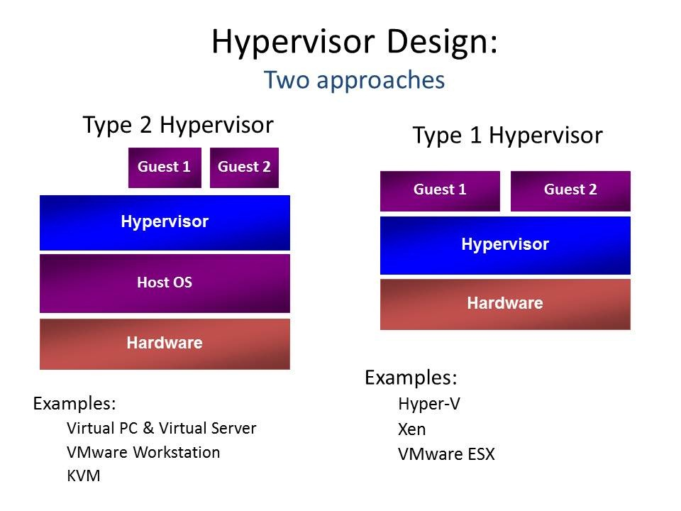
Virtualisation
The hypervisor drives the concept of operating system virtualisation by allowing the physical host machine to operate multiple virtual machines as guests.

Slide 15

Virtual Machine
A virtual machine (VM) is a software-based emulation of a physical computer. It allows you to run an operating system and applications in an isolated environment on a host machine. Virtual Machine run a complete operating system, including its own kernel, on top of a hypervisor. This means each VM includes the entire OS, along with the application and its dependencies. It required more CPU, memory and Storage
Some Popular VM Software
  Qemu
  VM Ware
  Virtualbox
  Microsoft Hyper-V
  LiveView
  Wine
  Wine Zero

Slide 16
Virtual Machine
.Log - the log of activities for a virtual machine.
.VMDK- the actual virtual hard drive for the virtual guest OS, Maybe a dynamic disk, it starts small and grows to a predetermined limit, or fixed disk, which does not change size.
.VMEM -A backup of the virtual machine's paging file which only exists of the VM is running or has crashed.
.VMSN - These are VMware snapshot files storing the state of the VM.
.VMSD-A VMSD file contains the metadata about the snapshot.
.NVRAM- This is the file that stores the BIOS information for the virtual machine.
.VMX- This is the configuration file for a virtual machine, such as the operating system, disk information, etc. This is a simple text file that can be easily edited.
.VMSS- File stores the state of a suspended VM.
.VMTM-This is configuration file containing team data.
.VMXF-If a virtual machine is removed from a team, this configuration file remains.

